Slide 1
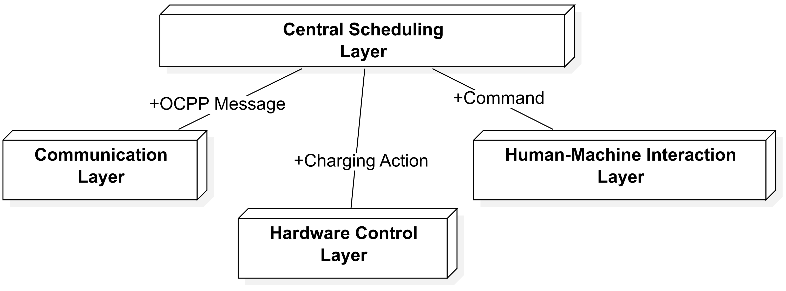
System structure
Notes:
Now, I will introduce the system structure of the charging station.
In this project, the system has four main layers: Communication Layer, Hardware Control Layer, Human-Machine Interaction Layer, and Central Scheduling Layer.

Slide 2
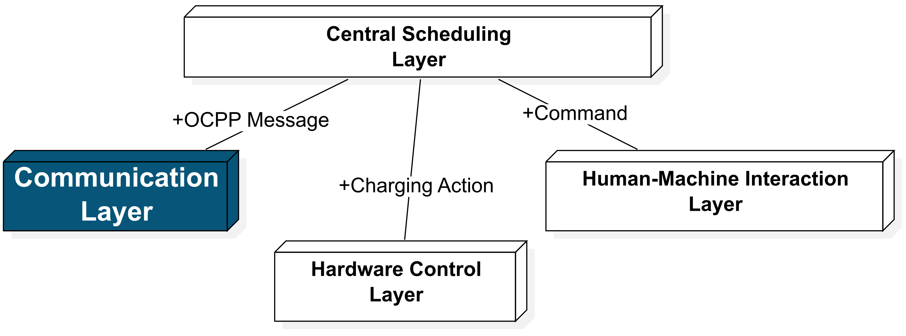
System structure——OCPP
Communication method:
WebSocket, used by OCPP officially
Execute type:
WebSocket: Asynchronously
OCPP-Library: Asynchronously
Message handle: Synchronously
Problem:
Low Concurrency
Optimizer: not support high concurrency
Charging Station: little influence
Low Scalability
message parsing and action execution are tied together
Solution:
signal-driven architecture to decouple
Notes:
Let's start with the Communication Layer. The main communication method is WebSocket, which is used by OCPP officially. WebSocket can receive messages asynchronously, so it doesn't block the thread. But because the official library handles messages synchronously, it cannot support high concurrency. For the optimizer, it is a problem, but it has little impact on the charging station. Because message parsing and handling are tied together, it has poor scalability. To solve this, we use a signal-driven architecture to improve scalability.
How does the communication work?

Slide 3
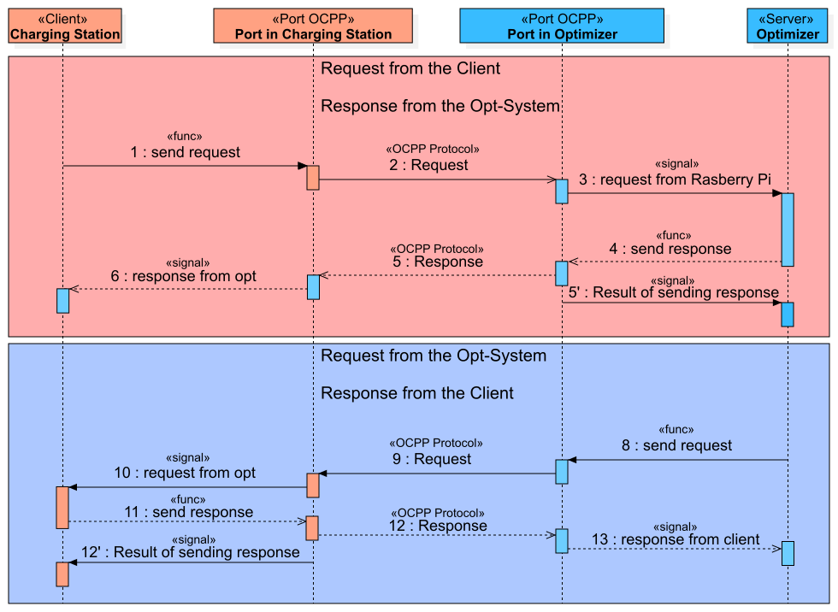
System structure ——OCPP
Request: import information
Response: confirm receipt
Notes:
Let's look at this diagram.
When we send a request to the optimizer, we first call a function to send the request. The charging station waits for a response from the optimizer. When the optimizer responds, the charging station parses the response and sends the message using signals. If the optimizer takes too long to respond, a signal will notify the system of a timeout. In this case, the charging station will receive a timeout error. The process is the same when the optimizer sends a request to the charging station. In general, important information is in the Request, and the Response is only for confirming receipt.

Slide 4
System structure ——OCPP
ref link
ref link
chargingProfile
chargingProfilePurpose
Enum doc.
ref link
chargingSchedule
Complex: deep nesting and many links
ref link
Low Efficiency : frequently look up the document to confirm the format and parameters
chargingSchedulePeriod
ref link
customData
ref link
Struct doc.
Notes:
OCPP messages are complex, with deep nesting and many links. It's like this — it's not very complex, we need just two jumps. But for this one, we need four jumps to see the definition, and it's easy to lose track of the previous link. To make this easier, we designed a message generator. Developers can call a function, and the IDE will show parameter hints. This way, developers don’t need to switch between the standard file and the code. It is more efficient and reduces mistakes.

Slide 5
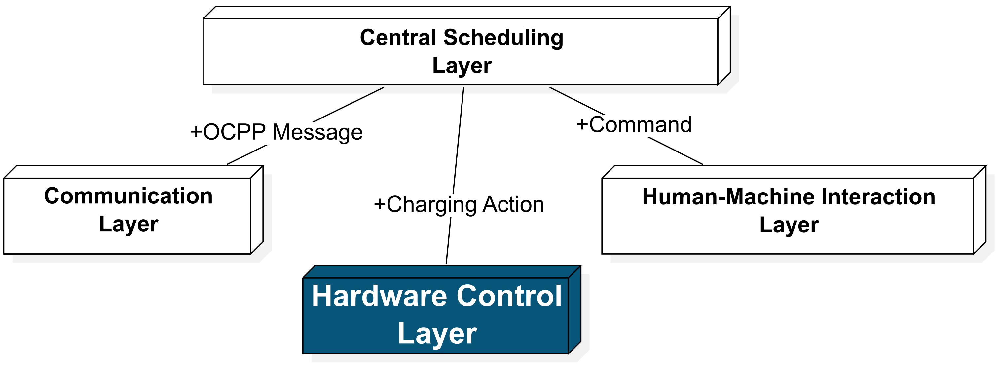
System structure ——Hardware Control
GPIO Management
Sensor Polling
LED
Management
Charging Unit
Data
Management
Notes:
Next is a very important module—Hardware control. It has five main parts: GPIO Management, Sensor Polling , Charging Unit, Data Management, and LED Control.

Slide 6
System structure——Hardware Control
GPIO Management Module:
The top-level module in the hardware control layer that manages submodules and coordinates their tasks
Features:
Manages lower-level modules.
Coordinates task scheduling and signal connections.
Communicates with higher-level systems.
Support multiple charging ports (evse, shelly, latch motor)
Notes:
The GPIO Management is the top-level module that manages all other modules. It coordinates task scheduling and signal connections, communicates with higher-level systems, and supports multiple charging ports.

Slide 7
System structure ——Hardware Control
Sensor Polling:
It is repeatedly checking sensors for data at regular intervals, such as vehicle status, charging current, power …
Sensor Polling
Data Collection
Data Management
Error Stop Charging
Charging Unit
For Safety
Check error
Works in a separate thread, so other tasks can keep running.
Notes:
The Sensor Polling collects sensor data at regular intervals and sends this data to the Data Management, such as vehicle status, EVSE status, charging current, power, and charged energy. If a sensor error occurs, this module notifies the Charging Unit to stop charging for safety. It works in a separate thread, so it won’t block the main thread.

Slide 8
System structure ——Hardware Control
LED Control
Manages the LEDs on the charging station to show status and alerts
Singleton (Ensures only one instance exists for consistent control)
Controls LED frequency and patterns
Data Management
Collects and processes data from all hardware
Supports data visualization on the GUI
Foundation for future database connections
Notes:
The LED Control and Data Management use the singleton.
The LED Control manages the LEDs on the charging station to show the status, it controls the blink frequency and patterns.
The Data Management collects hardware data and also support data visualization. If we connect it to database future, it is also a good foundation.

Slide 9
System structure ——Hardware Control
The Charge Unit Module manages a single charging port's operation, including executing charging, stopping, and triggering corrections to the charging schedule when needed.
Execute
Charging
Logic
Stop
Charging
Trigger of Correction
of
Charging
Schedule
Modbus Communication
with actuator
Notes:
The most important part of Hardware Control is the Charging Unit Module. The main tasks are to execute charging logic, stop charging, trigger the correction of the charging schedule, and handle error signals from other modules. Charging and stopping are executed by communicating with the actuator using Modbus. When an error occurs, the charging station stops charging immediately and unlocks the charging port.

Slide 10
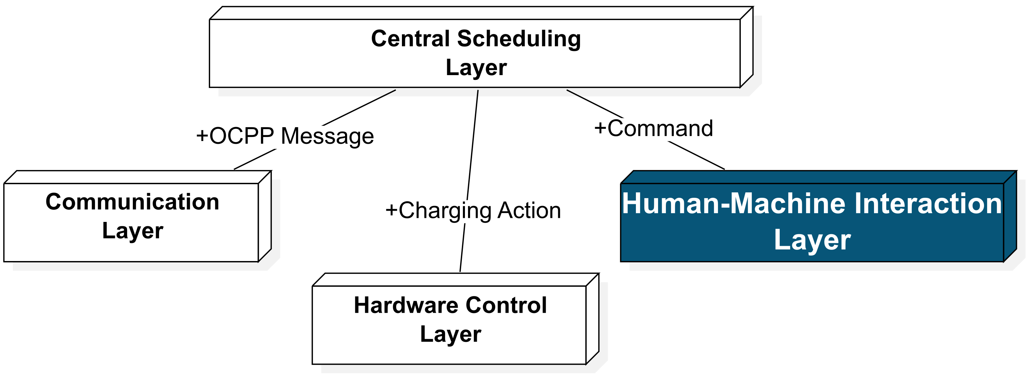



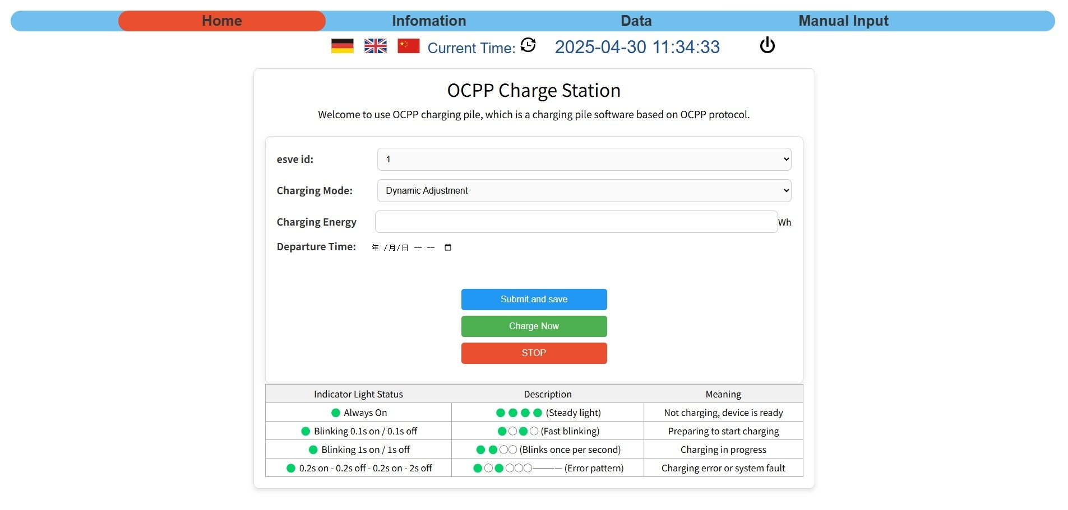
System structure ——GUI
The GUI Communication module connects the charging station to a web page.
Allows users to configure the charging station settings
Provides data visualization for real-time monitoring.
Enables control of the charging station directly from a web browser
Web Page
(HTTP)
Notes:
GUI Communication is executed by setting up a server. Users can control the charging station through a web page. This part will be explained by my teammate later.

Slide 11
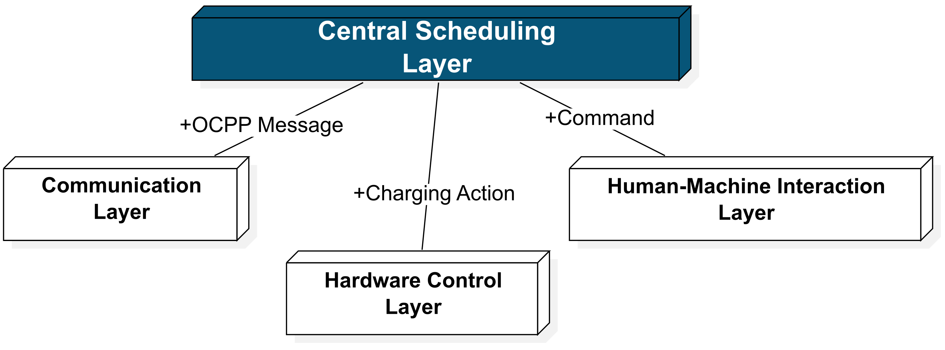
System structure——Central Layer
The Central Scheduling Layer:
the top part of the system that controls how all parts work together.
connect all modules
manage task scheduling
Sends and receives messages/signals between modules.
Notes:
The Central Scheduling Layer connect all modules and manage task scheduling.

Slide 12



System structure——Signal
Problem
Complex function calls
Solution
Create Signal class to decouple
Signal Caller
Advantages:
Compare to callback function:
more flexible (dis- / connect)
lower coupling
Disadvantages:
Additional Memory Overhead
Risk of Memory Leaks
Notes:
Because this system has complex function calls, we use signals to decouple the system. Compared to callback functions, signals are more flexible. We created a signal class referencing to Qt Signal. For example, when we have another function to be called, then we can connect it to the signal. If the signal is emitted, all connected functions will be called. When we no longer need a function, we can just disconnect it from signal. We don’t need to change the Signal Caller.
Next Yunan will introduce the charging logic part.

